Slide 1
Social Development in the Era of Digital Economy
Janette Toral
http://digitalfilipino.com

Slide 2
Case Study (play video)

Slide 3
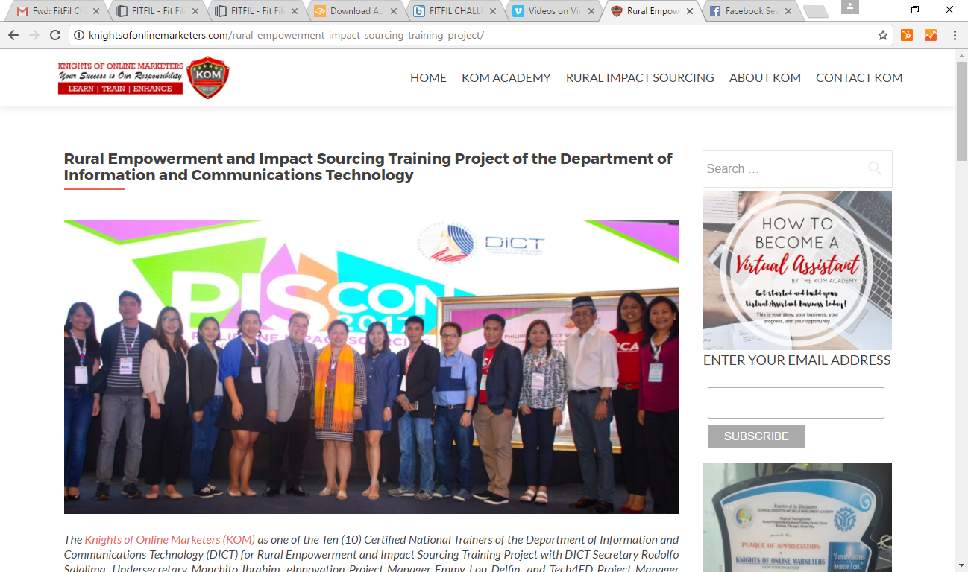
Bogo City Cebu
Carmona Cavite
Cabadbaran City
Dapitan City ZDN
Cauayan City
Dumalinao ZDS
Catanduanes
Plaridel MisOc
Lamitan Basilan
Balanga Bataan
Oton Iloilo
Polangui Albay
Alabel Saranggani
Tarlac
Tagum City
Maasin City S.Leyte
Quirino
Del Carmen Siargao
San Carlos City NegOc
Mati City
Masbate
Aurora
Zamboanga City
Allen N. Samar
Kalibo
Benguet

Slide 4
2017 RIS TECHNICAL TRAINING: ACCOMPLISHMENTS
534
200+
NUMBER OF GRADUATES WITH ONLINE JOBS
GRADUATES

Slide 5
2017 RIS TECHNICAL TRAINING: ACCOMPLISHMENTS
381
10,000,000.00+
(estimated)
NUMBER OF MSMEs HELPED TO HAVE ONLINE PRESENCE
REVENUE-GENERATED OF MSMEs

Slide 6
2018 RIS TECHNICAL TRAINING: COURSES – 70 rural areas
Digital Marketing and E-Commerce
Social Media Marketing and Advertising
Search Engine Marketing and Advertising
Content Writing
Web Development
Virtual Assistance
Graphic Design

Slide 7
What do you want the Future of Work & E-Commerce to be?

