Slide 2
Global e-Commerce Logistics - Massive Opportunity Ahead
The Rise of Cross-Border e-Commerce, Collaborative Communities and Logistics Marketplaces

Slide 3

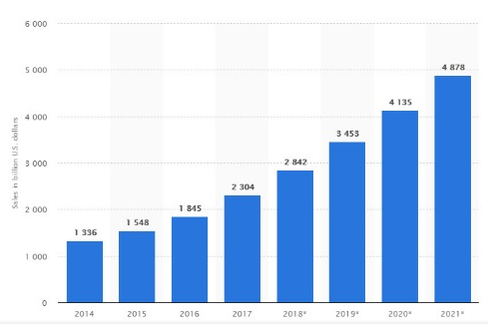



E-commerce Industry at a glance
Retail e-commerce sales worldwide
Globally, e-commerce, market is worth around $22.1 trillion
Global e-commerce Sales Will Double in Less Than 5 Years
Global internet connectivity, coupled with a growing shift toward the convenience of “e-tail,
Major e-Commerce markets – China, USA, Japan, Germany

Slide 4






The evolution of retail logistics
Suppliers
Shops
1970s Direct Store replenishment by suppliers or wholesalers
Mainly domestic suppliers
Retail distributions centers
Shops
1980s 'CENTRALIZATION' of deliveries through retailer distribution centers
Overseas supplier
Retail import center
Retail distribution center
Shops
1990s The rise of global sourcing
Domestic supplier
E-fulfillment center
Returns
2000s E-commerce model involving parcel network
Customer home
Parcel hub
Sortation center
Parcel delivery center
Collection point
Delivery Point
* Based on non-food distribution in developed markets
Local depot (urban logistics)

Slide 5




Role of Logistics in e-commerce
Cash Management and Reverse Logistics
First and Last Mile Delivery Management
Cash Collection and deposit as well repatriation
Managing customer returns, warranty execution, Return to origin
Reduce cost per delivery, maximize delivery person
Improve Attempt to Delivery Ratio, reduce failed attempts
Visibility across Order Life cycle
Market Place and Drop Shipment
Data Integration between varied systems of stake holders
Visibility across supply chain from warehouse to door delivery
Integrated logistics systems for inventory visibility Data Integration between varied systems of stakeholders
Direct shipment from vendor to customer

Slide 6
Logistics Value Chain: Complexity in operations

Slide 7







Air Cargo Cross Border e Commerce Supply Chain
2
4
LSP (Cargo agent)– First Mile
Air Cargo Aggregator
Origin Customs
1
Bag Acceptance
Attach AWB
Security Scanning
Manifest
On Ramp Operation
Loading
Origin Country
Airport Handler
3
Unloading
On Ramp Operation
Manifest
Bag level Warehousing
Bag Level Delivery
Destination Customs
Destination Country
LSP (Cargo Agent) – Last Mile
Airport Handler
5
7
6

Slide 8












Air Cargo Stakeholders - Interactions
1. Purchase Order/Sales Contract
Exporter
17. Invoice & Packing List
18. Debit Note
Importer
14. Air Waybill
15. Credit Note
16. Debit Note
4. L/C Notification
3. L/C Application
Importer’s Bank
2. L/C Application
Exporter’s Bank
5. Invoice & Packing List
6. Invoice & Packing List
7. Certification Request
8. Invoice & Packing List
9. Certificate of Conformity
46. Freight Arrival Notice
47. Handling Forwarder
28. Receipt
Insurance
57. Transport Order
Transporter
24. Invoice & Packing List
25. Air Waybill
60. Consignee
Receipt
27. Transport Order
Airline
Transporter
59. Receipt
26. Certificate of Insurance
39. Pouch
40. Air Waybill FWB
41.House Waybill FHL
42. Flight Manifest FFM
58. Receipt
10. Invoice & Packing List
11. Letter of Instruction
12. L/C Instruction
CB/FF
19. Booking
20. Air Waybill FWB
21. House Waybill FHL
61. Air Waybill
62. Customs Fees
63. Handling Fees
Airport Authority
13. Air Waybill
38. MRN
Customs
CTO
64. Handling Fees
36. ACI
43. Air Waybill FWB
44. House Waybill FHL
45. Flight Manifest FFM
Airport Authority
35. Flight
Manifest
37. MRN
Pouch Content:
House Waybill(Paper)
Invoice
Packing List
Certificate of Origin
Regulatory Documents
CTO
22. Air Waybill FWB
23. House Waybill FHL
29. Cargo Receipt FOH
50. Invoice
51. Air Waybill
52. House waybill
53. Import Goods
Declaration
54. Customs Fees
55. Customs
Release Imports
32. Pouch
33. Customs Rel. Exp.
Customs
CB/FF
30. Export Goods Declaration.
48. Pouch
49. Air Waybill FWB
34. Cargo Acceptance
31. Customs Release Exports
56. Custom Release Import

Slide 9




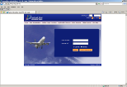
An example of the current documentation and information flow in Air Cargo Exports
Pre-alerts for Overseas Agents
Invoice
Packing List
SLI
SDDG
Freight
Forwarder/
3PL Provider
House Manifests, Invoice, Packing Lists
Customs
Manufacturer
Terminal Receipt
ERP Systems
Declarations, Manifest
Cargo Arrival, Release Order
Documentation System
Estimated 118 copies, 258 signatures, 22 hours of key-punching during exports clearance process
Source: IATA
3rd Party DEO
Airport Cargo Handler
MAWB
House Manifest
Other shipment docs
MAWB
House Manifest
Flight Manifest
Carting Order , Charges receipts, MAWB, Booking Lists, Manifests
Airline
Airline System

Slide 10








Maritime Stakeholders - Interactions
1. Purchase Order/Sales Contract
20. Invoice & Packing List
21. Debit Note
Importer
65. Receipt
Exporter
17. HBL
19. Debit Note
18. Credit Note
4. L/C Notification
Exporter’s Bank
3. L/C Application
Importer’s Bank
2. L/C Application
5. Invoice & Packing List
6. Invoice & Packing List
7. Certification Request
8. Invoice & Packing List
9. Certificate of Conformity
67. MBL
68. Handling Fees
13. Booking
14. SLI
46. Cargo Manifest
29. Receipt
28. Transport Order
15. MBL
Transporter
Shipping Line
Insurance
48. IGM
Shipping Line
Port
Port
10. Invoice & Packing List
11. Letter of Instruction
12. L/C Instruction
CB/FF
22.Invoice & Packing List
23. MBL
50. Clearing Payment
24. Certificate of Insurance
49. Via Road
49. Via Rail
51.DO
16. HBL
Customs
48. IGM
47. CAN
44.1 Port wise Document
52. BOE
CB/FF
66. Consignee Receipt
Customs
ICD/CFS
Warehouse
45. Pre- Arrival Notice
25. Shipping Bill
27. Carting Request
33. Storage of Cargo
34. Allocation of Empty Container
-TJO
-Train Summary
-WTR
58. Customs Examination
61. Transport Order
26. Shipping Bill No.
30. Gate In
31. Container Weighment
32. De-stuffing + Carting Tally
36. Inspection & LEO
59. Out of Charge
35. Stuffing
ICD/CFS
37. CLP
53.Container Inspection
54. Gate In
55.Weighment
Transporter
43. Payment Confirmation
56.1 FCL
62. Receipt
44. Gate Out
56. Seal Cutting
38. Movement Request
39. Forwarding Note
57. De-stuffing
Warehouse
40.Pre Load List
41. WTR
42. Train Summary
60. Loaded/Re-stuffing Delivery
56.2 LCL
63 Payment Confirmation
64. Gate Out
-Stored in Bonded Area

Slide 11
Collaborative Technology Platforms : Single Window and Cargo Community Systems

Slide 12
An end to end Digital Platform from Origin to Destination
2
1

Slide 13
An end to end Digital Platform from Origin to Destination
4
3

Slide 14
Collaborative Technology Platforms connecting the Logistics Value Chain

Slide 15

United Nation Recommendation no 33 for Single Window
Level 1 : Paperless Customs + e-Payment for Customs Duty + e-Customs Duty + e-Container Loading List + and electronic risk-based inspection
Level 2 : Connecting Other Government Back-end IT systems, and e-Permit Exchange with Paperless Customs System
Level 3 : e-Documents Exchange among Stakeholders within the (air, sea) port community
Level 4 : An Integrated national logistics platform with also traders and logistics-service providers information exchange
Level 5 : A regional information-exchange system
National e-Logistics Platform
A regional information-exchange system or cross-border paperless trade
Port-Community Information Exchange
Traders
Banks for various kinds of e-payment
Other Regulatory Bodies for E-Permits/e-Certificates Exchange
Insurance Companies
Freight Forwarders and Logistics Service Providers
Paperless Customs
SW
Internet
Airlines
Duty Free Zones
Importer/Exporter/Customs Broker/Representative/other Stakeholders
Air Port Authority Port Authority etc.
Ship Agents
Note that in many countries, Level 3 was being developed before Level 2.
Terminal Operators

Slide 16









Electronics goods Exports from China ( to India)
Business Process
Electronics Goods Exporter
1
Regulatory Single Window
China Company Registrar
Ministry of Commerce
China Customs
3
Marketplace
Business Registration
China Foreign Trade Registration
Category allocation & Customs Certificate
Trade Process
Identify Buyer
Identify Logistics Service Provider
China Electronic Standardization Institute
China Certification Center for Quality System of Electronic Industry (CCQE)
China chambers of commercre
Product Certification
Quality Standardization
Certificates of Origin (COO)
2
Cargo Community Platforms
Logistics Process
Freight Forwarder / Customs Broker
Transporter
Cargo Terminal
Airline
China Customs
File Customs declaration
Get Published Rates
Make booking
Last Mile
Consignment Note
Carting Order
Terminal Charge Creation
Security and Acceptance
Customs Facilitation
Accept Booking
Issue AWB
Manifest filing
Approve declaration
Release Order
Manifest acceptance

Slide 17

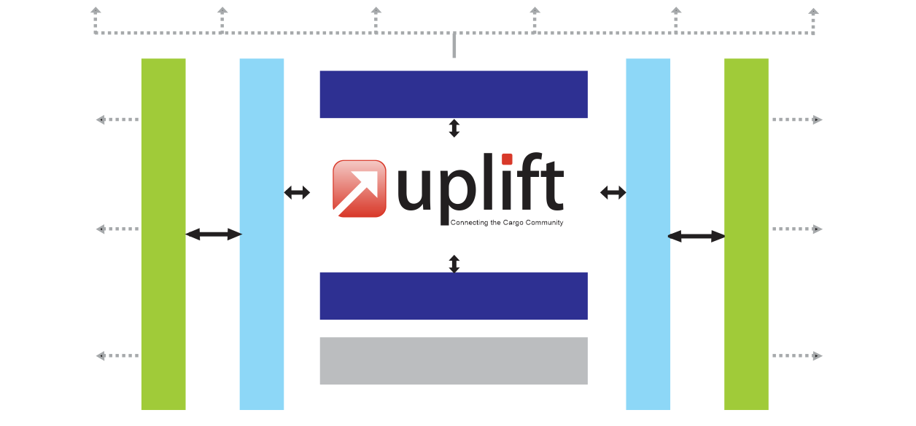


Multimodal Trade Facilitation Platform- UPLIFT
Railways
Customs Broker
Shipper /
Consignee
Forwarder
Transporter
Liner
Web Portal
Airlines
Customs Broker
Custodian/
Ground Handler
Internal System
UPLIFT Adapter
Internal System
UPLIFT Adapter
Transporter
Customs Single Window
Bank
Customs
Forwarder
UPLIFT - A Multi-modal Trade Facilitation Platform

Slide 18

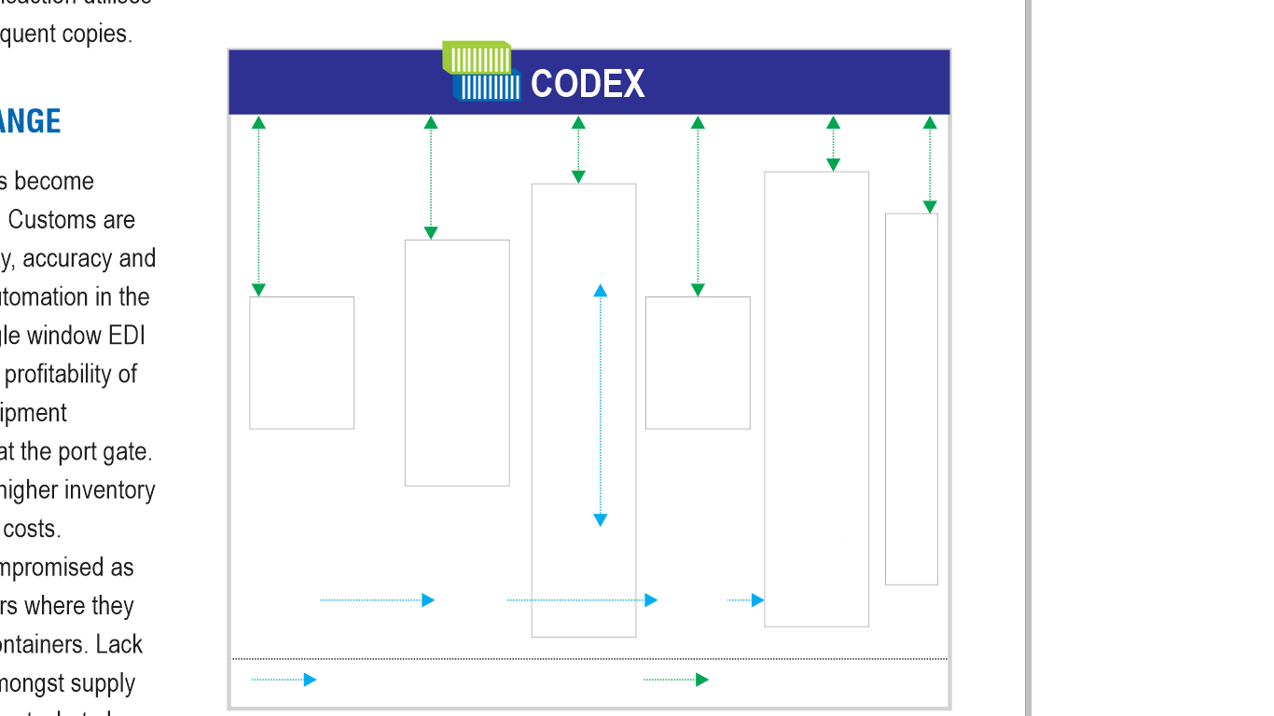











Components of Logistics Single Window - ACS & PCS
Port Community System
Gate Pass
Truck Number
Customs Document
Booking with Terminal Operator for space allotment
Document
Validation
Allowed for
Shipment
Time for
Shipment
EIR Approval
Yard Management
EIR
Carting
Approval
Manifest
Manufacturer
Freight Forwarder/Broker
3PL Provider
Port Customs
Terminal
Operator 1
ERP Systems
Invoice Packing List
Documentation
System
Terminal GATE
Shipping Bills & other declaration doc Carrier booking Waybills,
Status updates
Imports goods declaration,
Terminal Storage Charges,
CAN, DO
CFS Customs
PORT Authority
Air Cargo Community System
CUSTOMS
Port Security
Shipping
Bill
Export Cargo declaration
Exports manifest Cargo arrival
Customs Release Order
Imports Cargo declaration,
Import manifest, Customs Release Order
MAWB/House Manifest FSU
CAN, DO, FFM, FSU
Terminal
Operator 2
Customs Broker
MAWB House Manifest
Flight Manifest
Transport Movement
Airline
Physical Flow of Cargo
Digital Information Flow of Cargo
Airline System
Cargo Handler
ACS
PCS

Slide 19
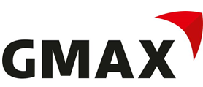

















Connecting stakeholders at Mumbai Airport on a collaborative platform
GMAX: Empowering unregulated operators to transact digitally e-Booking, e-AWB, e-Customs, e-Chamber fo Commerce etc.
Booking/Transport/Tracking
Booking/Documentation/Tracking
Exporter
Forwarder
Airline
100+ Airlines
Documentation/Clearance
Job info
Payments
Certificates
CHA
Payments
Banks
Unregulated Cargo Operators
Unregulated Cargo Operators
CHA
Forwarder
Airline
Octroi docs
Municipal Corporation of Grater Mumbai
Duty Payments
Loading instructions, Manifest
2000+ Agents
Municipal Corporation of Grater Mumbai
Chamber of Commerce
Customs and Allied regulators
Exporter
Chamber of Commerce
Customs and Allied regulators
Banks
Landside Area
Cargo Terminal
Airside Area
Landside Area
Cargo Terminal
Airside Area
13 Statutory Bodies including Customs
Regulated Cargo Services
Cargo Terminal Operator Processes:
Receipt of Cargo, Weightment, Screening, Storage, Palletization, Customs Inspection, Airside movement, Aircraft Loading
Regulated Cargo Services
Cargo Terminal Operator Processes:
Receipt of Cargo, Weightment, Screening, Storage, Palletization, Customs Inspection, Airside movement, Aircraft Loading
Parameter
Pre GMAX
Post GMAX
Document handled ( including copies)
128
24
Avg Queue Time for document/payments
1 hr 20 minutes
Nil
Airport Counters
9
1
500+ truckers
Average time per export doc handling
28 minutes
6 minutes
Average time per import doc handling
22 minutes
8 minutes
Accuracy of data
85%
94% +
Waiting time for Export Trucks
2 hours+
30 minutes
Availability of data to stake holders
Through Mail, calls and in person
Portal, EDI, App, On Demand

Slide 20





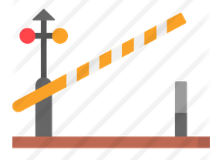














Accelerating container movement a Container Digital Exchange
Scenario without CODEX
Scenario with CODEX
Gate Pass
Truck Number
Customs Document
Booking with Terminal Operator for space allotment
Document
Validation
Allowed for
Shipment
Time for
Shipment
EIR Approval
Yard Management
EIR
Carting
Approval
Manifest
15 CFS/ICD
Invoice & Packing List
Forwarder
DO & MBL
Shipping Line
EIR & Terminal Fee
Port Customs
Terminal
Operator 1
Invoice & Packing List
EIR & Port Fee
Port Terminal
Operator
1Mn TEU/annum
Certificate of Origin
Terminal GATE
EIR & MBL
Port Operator
CFS Customs
PORT Authority
Shipper /
Consignee
Port Security
Shipping
Bill
12 Vessel Operators
Invoice & Packing List
Port Security
Invoice & Packing List
Container Depot
(CFS/ICD)
Terminal
Operator 2
400 Agents
500+ Exporter/Importers
Customs Declaration Files (SB)
Customs Broker
Invoice & Packing List
Transport Movement
Customs Broker
Invoice & Packing List
Customs
Physical Flow of Cargo
Digital Information Flow of Cargo
Container dwell time from
2.5 hours to 25 minutes
Document copies for port entry reduced from 15+ to 2
Shipment related documents made available for approvals & processing
300Transporters
One common information highway connecting all
Improved capacity planning
at terminal
No separate application required by Shipper, CFS/ ICD for operations
Shipment visibility based
on rights
Eliminated possibility of
un-cleared shipment
Mobile App enabled
on- the-go tracking
Business Benefits

Slide 21
Digital Corridor- Powering Regional Single Windows

Slide 22










Trade Facilitation Platforms: Full Services Play
Home Country
National Single Window
Destination Country
Digital Corridor
Logistics Single Window
Regulatory Single Window
Customs Single Window
Air Cargo Community
Port Community
Air
Ocean
Customs
Air Cargo Community(ACS)
Airport Community System
e-Manifest | e-DO
Container Digital Exchange (PCS)
e-Manifest | e-DO | e-VGM | UCC
Rail/Road Community Platform
Exporter/
Shipper
Forwarder
Customs Broker
Transporter
Railways
Container Depot
Warehouse
Export Customs
Carrier
Import Customs
Forwarder
Customs Broker
Transporter
Railways
Export
Port/Airport
Import
Port/Airport
Container Depot
Warehouse
Importer/
Consignee

Slide 23
Digital Air Corridor between India & Netherland
A Digital Air Corridor is being established between Mumbai and Schiphol
Uses Blockchain.
1
2
3
Connects exporters, importers, agents, ground handlers, Airlines from both stations to have real time visibility of the shipment

Slide 24
Digital corridor- India -Netherland
India- Kale’s GMAX
Netherland- Cargonaut
Digital Corridor enabled by Blockchain
Customs Information
Export/Import
Import/Export
Customs :Customs clearance, COO, Manifest
Customs : Customs clearance, COO, Manifest
Participative Government Agency- License and Permits
Participative Government Agency
Security Certification Agencies
Security Certification Agencies
Shipment Documents
Shipment Documents
Status of cargo at airport
Status of cargo at airport

Slide 25






Digital Air Corridor - Exports Information Flow
Information Exchange Flow- Exports
Freight Forwarder
Freight Forwarder
FOH – Freight On Hand
RCS – Receive from Shipper
Origin
Origin Handler
Carrier
Destination
4. MAN – Shipment Manifestation
5. DEP – Shipment Depart
View
View
Air Cargo Community System
Air Cargo Community System
3. Customs Release
Export Customs
Shipper
Consignee

Slide 26
Digital Air Corridor - Import Information Flow
Information Exchange Flow- Imports
Freight Forwarder
Freight Forwarder
ARR – Flight Arrived
RCF – Receive from Flight
Origin
Destination Handler
Carrier
Destination
3. NFD – Notification for Delivery
DEP – Shipment Depart
6. DLV – Shipment Delivered
View
View
Air Cargo Community System
Air Cargo Community System
5. CCD – Shipment Custom Cleared
Import Customs
Shipper
Consignee

Slide 27
Marketplace Model for Multi Modal Logistics

Slide 28

Trade Facilitation Platforms: Full Services Play
National Trade Platform
Logistics Single Window
Logistics Marketplace
Air
Ocean
Logistics Services repository
Demand Supply match
Price Discovery
Air Cargo Community(ACS)
Airport Community System
e-Manifest | e-DO
Container Digital Exchange (PCS)
e-Manifest | e-DO | e-VGM | UCC
Rail/Road Community Platform
Exporter/
Shipper
Forwarder
Customs Broker
Transporter
Railways
Container Depot
Warehouse
Export Customs
Carrier
Import Customs
Forwarder
Customs Broker
Transporter
Railways
Export
Port/Airport
Import
Port/Airport
Container Depot
Warehouse
Importer/
Consignee

Slide 29
COMPLEX TRADE LOGISTICS SECTOR
EXPORT
PROMOTION BOARD /CHAMBER OF COMMERCE
MULTIPLE PERMITS &
CERTIFICATIONS
MULTIPLE GOVERNMENT AGENCIES
COMPLEX TRADE RULES
SEVERAL COMMODITIES
BILLION $
MARKET SIZE
LARGE
EMPLOYMENT BASE
MULTIPLE LOGISTICS AGENCIES
MANY WAREHOUSES/DEPOTS
DISCONNECTED IT PLATFORMS
BANKS & INSURANCE AGENCIES
36 LOGISTIC SERVICES

Slide 30



LOGISTICS e MARKETPLACE- CONNECTING THE FRATERNITY
START
1
Plan end to end shipment route
2
Check availability
3
Rate enquiry
4a
Select Freight Forwarder/Broker
10
View trade analytics
4b
Book ocean freight
Availability
Price Discovery
ePayment
Online Grievance Redressal
9
4c
FEATURES
Book truck/Rail
8
Monitor Physical Flow of Goods
Service Provider Rating
Digilocker
Track & Trace Shipment
4d
Book
warehouse
Pay electronically
7
Book Other Logistics services
4e
Book air freight
6
Invoice Generation
5
Exchange
eContract
4g
Book Packaging Services
4f

Slide 31





Logistics Marketplace
Agent Rating on SLA
Exporter/Importer
Regulatory Single Window
Invoice
Packing List
RFQ
RFQ
Dashboard
Exporter/Importer list
Global Tenders
Global Trade News
Promotions
Export/Importer Guidelines
Booking sent
Freight
Forwarder
Booking sent
Carrier
Find Agent
Rates Scheduling
Booking Confirmation
Rates Scheduling
Booking Confirmation
Booking sent & confirm
RFQ
Booking
Cargo Community Systems
Customs Broker
Transporter
List of CBs
List of Transporters
eTrade Portal
Transit Insurance
eMarket Place for Exports/Imports

Slide 32




Logistics Community Technology Framework Model
1
Customs Authority
Ministry of Trade and Commerce
Other Participating Government Agencies
2
Regulatory Single Window
National Trade Logistics Platform
Digital Corridor
Partner Countries
Customs, Ports and Airports
Exchange Cargo Status
Exchange Documents
Exchange Customs Information
Existing Trade Facilitation Infrastructure
Logistics Single Window
Freight Forwarder
Customs Broker
Container Depot
Warehouse
Trucker
Port
Airports
Shipping Line
a
b
Trade Market Place
Exporters/Importer Marketplace
Logistics Service Provider Database
Services offered
Rates and schedules
Optimized transportation plans
Bookings on Carriers
Service Provider Work ratings
Trade Analytics

Slide 33
Blockchain : Powering Digital Logistics Trade Platforms

Slide 34




E-Certificate of Origin- Moving towards Blockchain
Destination Country
Document submitted on Blockchain network
Freight
Forwarder / Customs Agent
CoO + invoice + packing list is applicable
Customs
Prints & Submits & carries in person
Manual in person CoO approval at Chambers
Transmission on Blockchain network with digital signature
Exporter
Rejected documents sent back to Exporter
Rejected Invoice & Packing List sent back t
Invoice/ Packing List
Verify/Approve/ Reject Invoice & Packing List
Originating Country
Approved documents stamped and handed over to FF/Custom Agent
Verification, authentication and issuance on Blockchain network

Slide 35
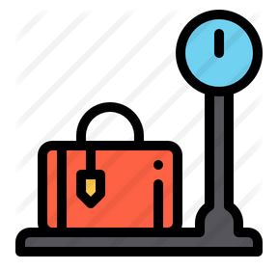






eVGM-Process Flow
Shipper/ Broker
Factory Stuffed Container
Weighment at Shipper premises/Registered weighbridge
Vessel operator
VGM information of the containers that shippers provided
VGM information when a terminal operator weighs a packed container on behalf of the shipper
VGM information of the containers that shippers provided
Terminal Operator
Shipping Line
Shipper
Provide VGM information of the container to be loaded to carrier or terminal operator
Cargo
Container Depot
Weighment at Container Depot/ weighbridge
Loaded container is weighed to gain VGM.
Information is electronically sent to Shipping Lines and Terminal Operators
Faster & Simpler workflow
Lower risk of data loss/damage
Increased Security
Information in advance

Slide 36



Blockchain in E-Phyto certificate
ePhyto is short for “electronic phytosanitary certificate”. ePhyto is the electronic equivalent of a paper phytosanitary certificate. The National Plat Protection Organisation(NPPO) of exporting countries issue phytosanitary certificates which need to be directly made available for the NPPO of the importing country. ePhyto is produced, transmitted and received in XML.
E-Phyto flowchart
  XML data transmitting
  NPPO of exporting country
  Feedback if any
  NPPO of importing country
  Providing data
  Feedback if any
  Import process
  Feedback if any
  Exporters
  Importers
Faster & Simpler workflow
Lower risk of data loss/damage
Increased Security
Time & cost saving
Information in advance

Slide 37
Thank You

