Slide 1
““Network of Trusted Networks - collaboration across logistics and electronic exchange platforms for cross border trade.””
Richard Morton
Secretary General
International Port Community Systems Association
19-20 October2018
7th APEC E-Commerce Business Alliance Forum
Xi’an, Shaanxi Province, China

Slide 2
Collaboration
Collaboration is at the heart of cross broder trade
Change dynamics, particularly eCommerce, means there needs to be a step change in collaboration
Collaboration
“The action of working with someone..”
Key Requirements for Collaboration:
Trust
Mutual Ambitions
Business case
Transparency
Trust

Slide 3
Collaboration in eCommerce. Why ?
Technology and telecommunications advances now enables every person to access products and services globally
Consumers rather than manufacturers are driving the driving force of eCommerce
Expectations of “instant gratification”
“Without any sympathy for the work necessary to accomplish it, consumers want what they want where they want it and when they want it.”¹
1. Eye for transport, hot trends Q1&2 2018

Slide 4
Logistics Revolution - drivers
Seen a shift to Business to Consumer logistics
Different logistics requirements are needed to adapt to this change
However to effectively deliver some challenges have to be overcome:
Collections from multiple business but small in scale
Consolidation at centres around the globe
Delivery direct to consumers
Cross Border regulatory compliance issues
Expectations of consumers and tracking of consignments

Slide 5
Logistics Revolution - drivers
A recent report² identifies that retailers and manufacturers biggest challenges are:
Navigating customs compliance (51%)
Tracking deliveries across borders (46%)
Managing delivery expectations (43%)
Managing risk across borders
Creating seamless experience for overseas consumers
Cross-border logistics
Cross-border returns
Working with partners across borders
Data from consumers across borders
2. Eye for transport, hot trends Q1&2 2018

Slide 6
Logistics – cause and effect
This leads to potential disruption³:
Retail and other forms of property will also go through ‘re-logistification’, which will effectively combine retail and logistics. –
The more the inventories are integrated into urban retail shops, they are used as small warehouse facilities to cater to eCommerce operations.
The use of mobile warehouses that are parked at strategic locations in cities for better and flexible distribution.
Traditional Logistics models need to adapt
Cross Border logistics need to improve
3. Impact of Growing eCommerce Business on Logistics Sector, Shiprocket, Praveen Sharma Jan 2018

Slide 7
eCommerce and Trade Facilitation
Effective Trade Facilitation for eCommerce is critical
The consumer doesn’t understand or even care about where goods come from and the processes involved
Customs and other administrative processes should be streamlined in parallel to those of the logistics sector.
How can this be practically implemented…………………………………..

Slide 8
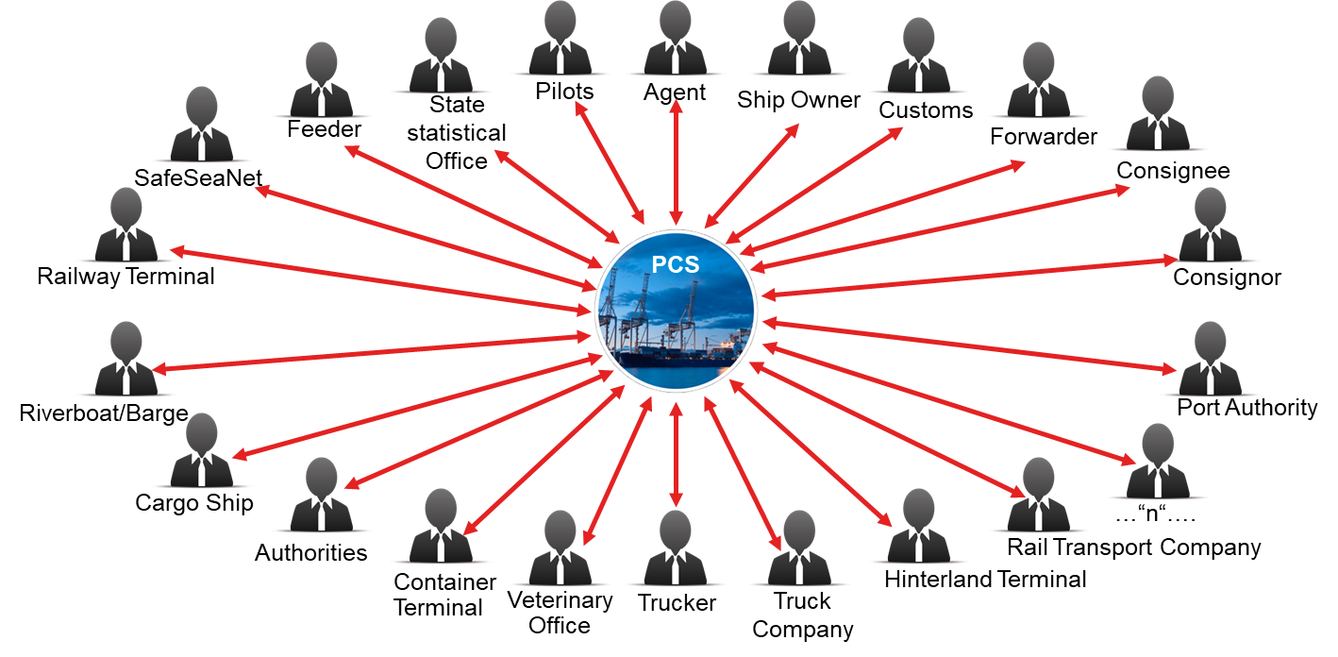
Community System – collaboration platforms
Port Community Systems have been creating efficiencies in sea and air ports for nearly 40 years through the electronic exchange of information.
Exchanging data electronically is not new
The biggest challenge is trust and neutrality. Community Systems are both a trusted third party and neutral actor.
Transparency is needed

Slide 9
Network of Trusted Networks Globally Connected Logistics
Value Proposition of Community Systems
Existing global network of Systems with over 1 million users
Trusted and Neutral
Using and developing international open standards
Vision:
A neutral and trusted network
Globally Connecting Logistics
Use of existing IT Infrastructures not new ones
APIs to connect Community Systems
Simplified User Authorization

Slide 10
What and How to Exchange
Problem: Visibility and the lack of it
Public versus Private Data
Survey or participants
Vessel Status
Container Status
APIs (Application Program Interface)
No current standards for API, IPCSA has developed it’s own for exchanging information
Relatively easy to implement
Standards
Use of international standards

Slide 11
Network of Trusted Networks – The Vision

Slide 14
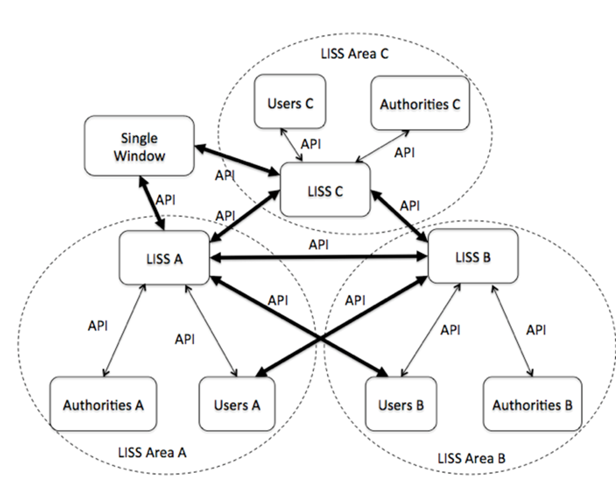
Global Data Sharing – ISO TC154/JW8

Slide 15
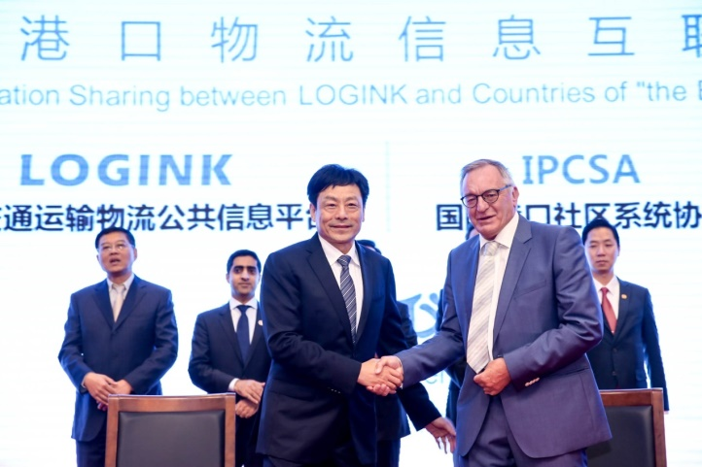
IPCSA and NEAL-NET Cooperation (North East Asia Logistics Network)
The Reality: Network of Trusted Networks
IPCSA:
PORTIC, Spain
Antwerp Port, Belgium
Trieste Port Italy
Odessa Port, Ukraine
Portbase, Netherlands
Maqta Gateway, Abu Dhabi
1-STOP, Australia
DBH, Germany
DAKOSY, Germany
ValenciaportPCS, Spain
Bilbao Port, Spain
PORTEL, Spain
MCP, UK
Israel Ports
China:
Ningbo Port
Qingdao Port
Dalian Port
Zhoushan Port
Wenzhou Port
Jiaxing Port
Qinzhou Port
Fangcheng Port
Beihai Port
Zhuhai Port
Japan:
Tokyo-Yokohama Port
Kawasaki Port
Osaka Port
Kobe Port
Yokkaichi Port
Niigata Port
Korea:
Busan Port
Kwangyang Port
Incheon Port
Ulsan Port
Pyeongtaek Port
“Soon to Come SEAL-NET”(South East Asia Logistics Network)

Slide 16
In Conclusion
eCommerce is changing the dynamic for collaboration:
Retailers and manufacturers are more consumer driven than ever before – Consumers need more transparency
Logistics needs to adapt and to trust
Administrations need to consider how to support Trade Faciliation whilst managing risks
Reduce the requirement for paper based transactions
Trust and Transparency will all lead to greater visibility in the whole supply chain and improving the efficiencies of eCommerce

Slide 17
IPCSA – Faciliating Data Exchange
Members in every region of the world.
1 million + users within our members around the world
Estimated 20 bn + electronic messages a year
Members currently handle the exchange of information for over 150 air and sea ports, this equates to over 500m TEU and 8bn tonnes of cargo. With NEAL-NET relationship 50% of world maritime trade.
IPCSA membership covers:
Air and Sea Port Community System Operators
Air and Sea Port Authorities
Single Window Operators
International and Regional Organisations

Slide 18
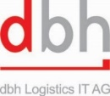
Richard Morton, IPCSA, Secretary General
E: richard.morton@ipcsa.international
Associate Members
IPCSA Annual Conference, Morocco 12-14th November 2018

